Slide 1


Slide 2
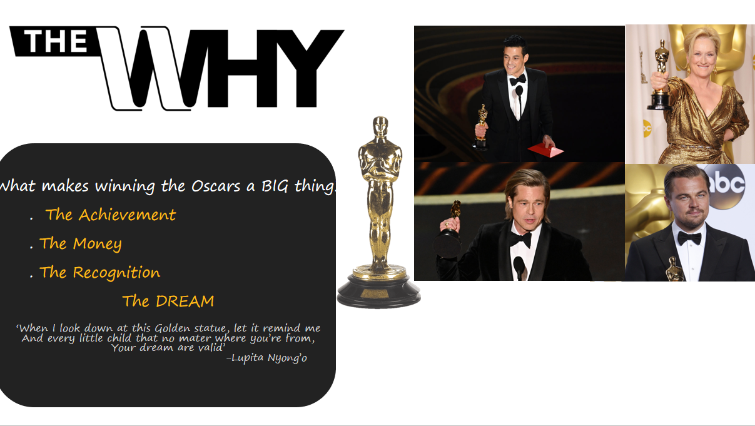

Slide 3
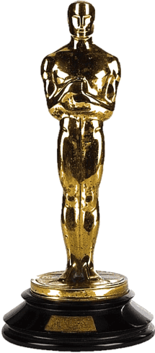

Preprocess the data
Find attributes which affect the decision making process
Build model using regression functions
Predict and validate your model
Notes:
Winning an Oscar is considered as a life time achievement in the movie industry so the directors,producers and actors involved are really interested to know what factors increase their chance of winning one.Hence there is a lot of research going on in this field to predict the probability of a movie winning an Oscar.Good amount of data is available to understand the pattern present and how the factors correlate with each other.Researchers have used many techniques to determine these factors.In this paper we aim to use statistical analysis to understand how the Oscar winnings is influenced by various factors and to see if there are any hidden parameters involved and to finally build a predictive model that predicts the probability of a movie winning an Oscar in any category.From the data set we have we begin to analyse the different attributes present and based on general intuition make assumptions on how these attributes(like user ratings,duration) can be related to Oscar winnings. Thereafter we begin to preprocess the data by removing duplicate values ,replacing null values and normalising the entire data set.To get a better understanding we to represent these data visually by plotting bar graphs,scatter plots and other visual aiding techniques.After this with the help of regression model important attributes were found and model was built on the basis of these attributes.Finally predictions were done with the help of test data and after getting the probabilty we checked in the internet to see if any of the movie had actually won an Oscar in that respective category

Slide 4
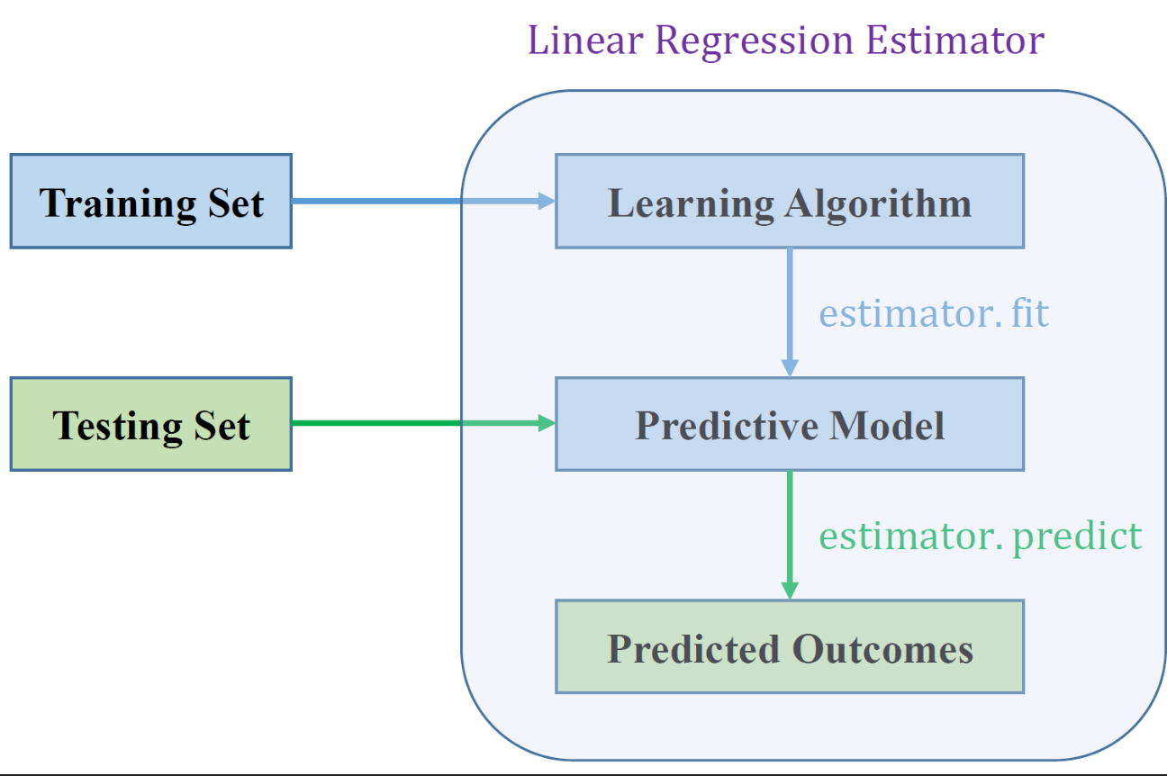
Code Presentation and Validation

Slide 5
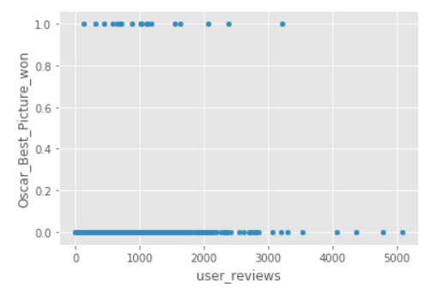
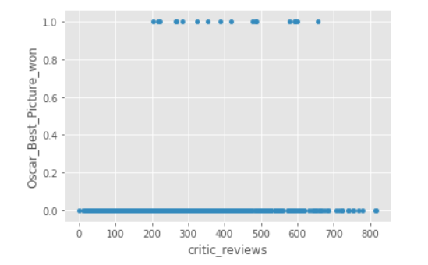
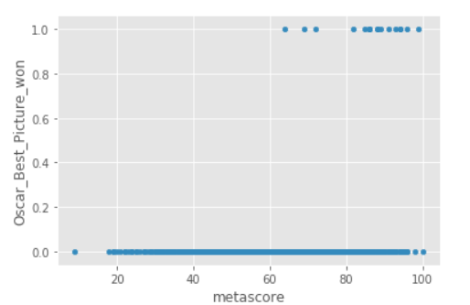

Interesting insights on the data

Slide 6
